Slide 1
PAPER FOLDING BACKING UP

Slide 2



FORM 1
FORM 2
FORM 3
FORM

Slide 3



INITIAL FORM
FORM CHANGE
FORM

Slide 4
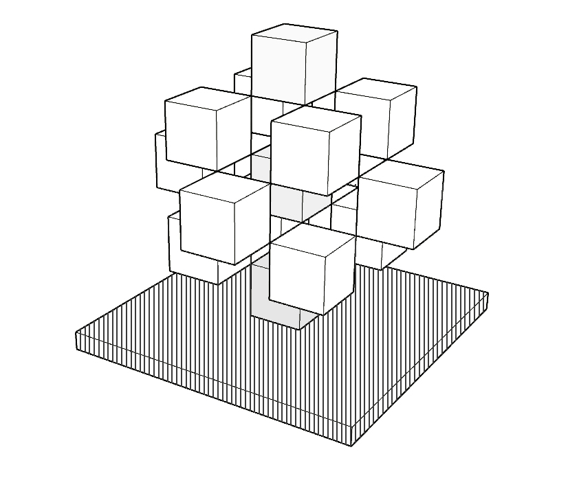
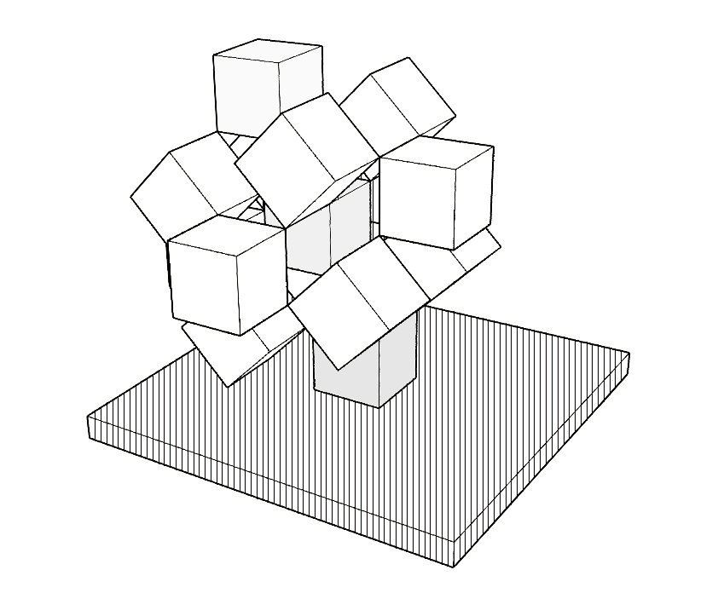
INITIAL FORM
FORM CHANGE
FORM

Slide 5

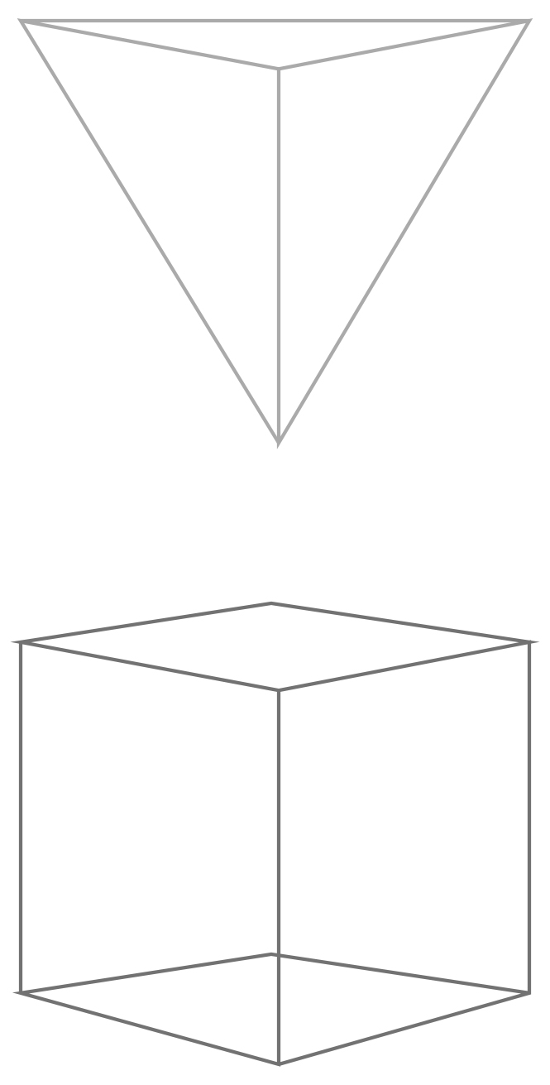

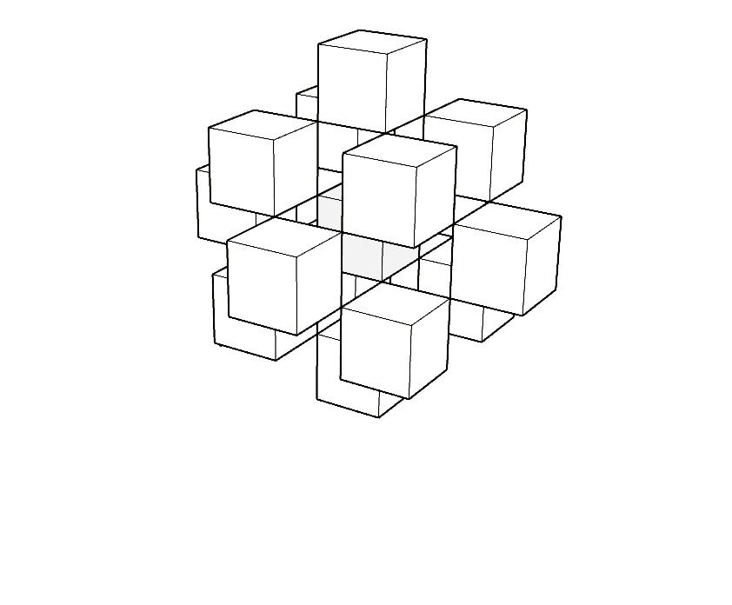
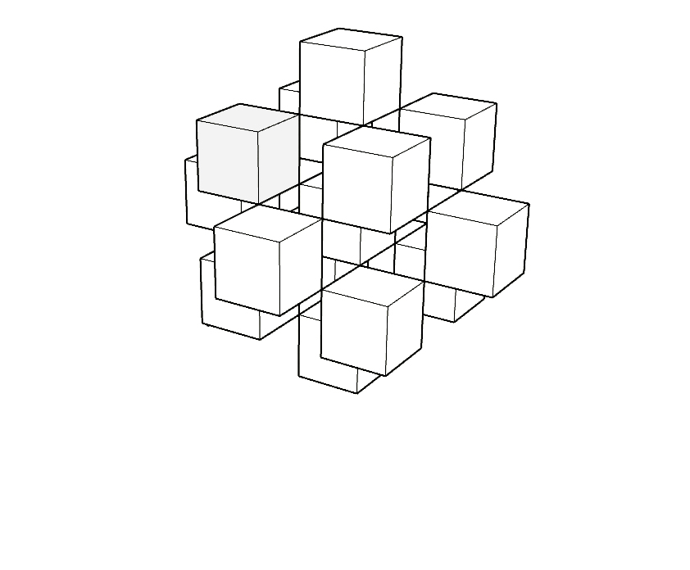

CONNECTION

Slide 6
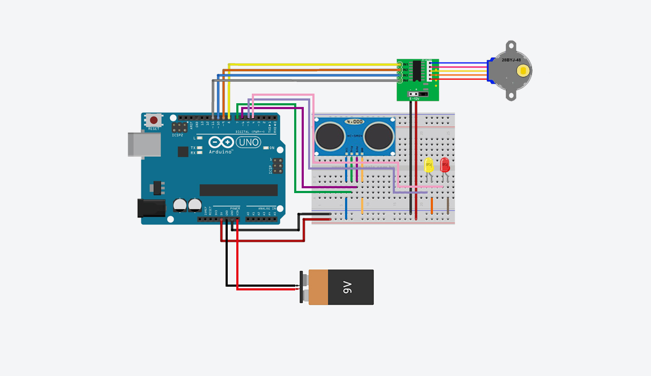
#include <Stepper.h>
const int stepsPerRevolution = 2048; //2048一圈
Stepper myStepper(stepsPerRevolution, 3, 5, 4, 6);
Stepper mysecond(stepsPerRevolution, 6, 4, 5, 3);
int trigPin = 11;
int echoPin = 12;
long duration, cm, inches;
int ledPin = 13;
int pirPin = 8;
int pirValue;
void setup() {
myStepper.setSpeed(10); //速度
Serial.begin(9600);
for(int pinNumber = 7; pinNumber<9; pinNumber++)
pinMode(pinNumber, OUTPUT);
digitalWrite(7, LOW);
Serial.println("clockwise");
myStepper.step(stepsPerRevolution);
mysecond.setSpeed(10);
Serial.begin(9600);
Serial.println("offset");
mysecond.step(stepsPerRevolution);
delay(50);
pinMode(trigPin, OUTPUT);
pinMode(echoPin, INPUT);
pinMode(ledPin, OUTPUT);
}
void loop() {
digitalWrite(trigPin, LOW);
delayMicroseconds(5);
digitalWrite(trigPin, HIGH);
delayMicroseconds(10);
digitalWrite(trigPin, LOW);
pinMode(echoPin, INPUT);
duration = pulseIn(echoPin, HIGH);
cm = (duration/2)/29.1;
inches = (duration/2)/74;
if(cm < 20){
digitalWrite(8, LOW);
digitalWrite(7, HIGH);
myStepper.step(stepsPerRevolution);
}else if(cm >= 20 ){
digitalWrite(8, HIGH);
digitalWrite(7, HIGH);
}
pirValue = digitalRead(pirPin);
digitalWrite(ledPin, pirValue);
Serial.print(inches);
Serial.print("in,");
Serial.print(cm);
Serial.print("cm,");
Serial.println();
// step one revolution in one direction:
}
ARDUINO

Slide 7
PAPER FOLDING FORMER EXPERIMENTS

Slide 8

FORM 1
FORM 2
FORM 3
FORM 4
FORM

Slide 9
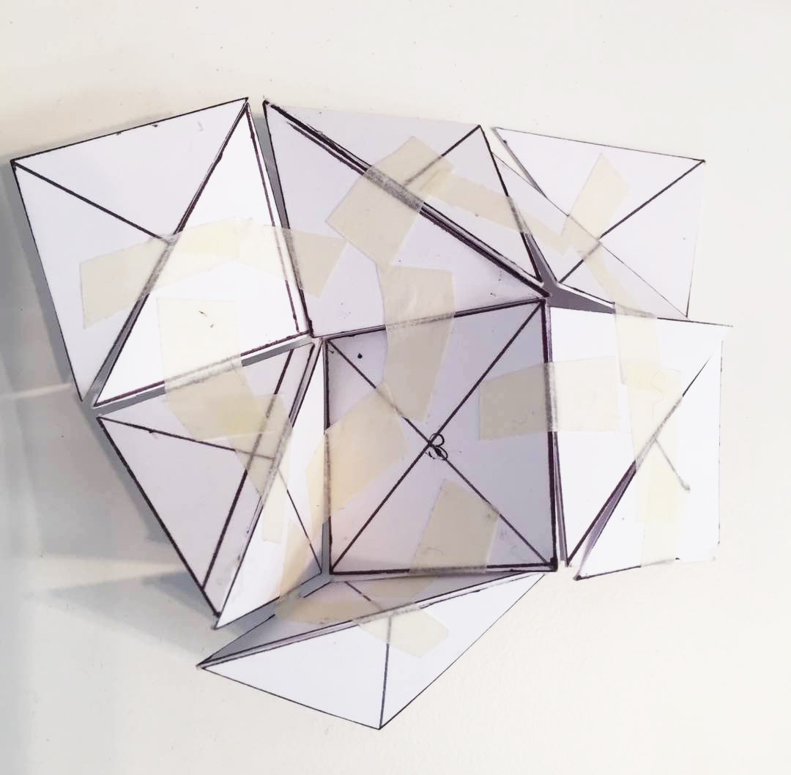
CONNECTION

Slide 10
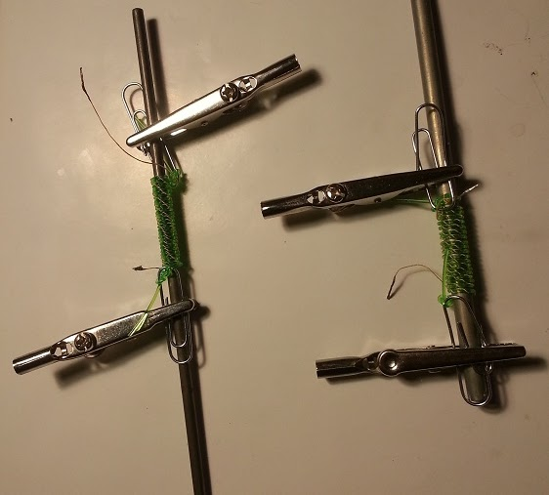
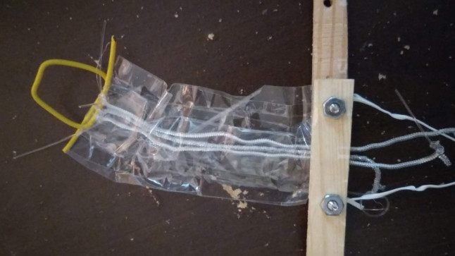
Nylon Test
· fishing rod
· acetate tape
· currents
EXP 1

Slide 11
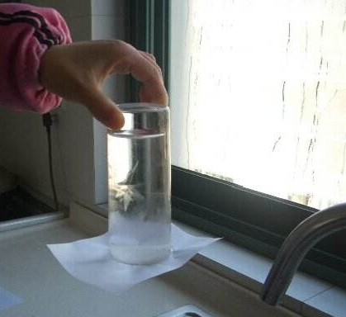
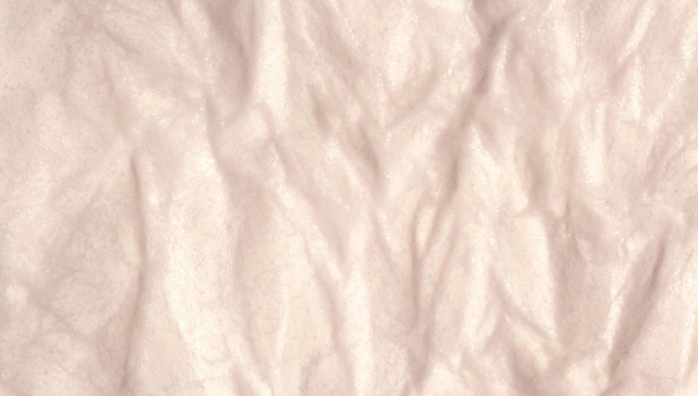
Liquid Test
· drawing paper
· water
· hot fan
EXP 2

Slide 12
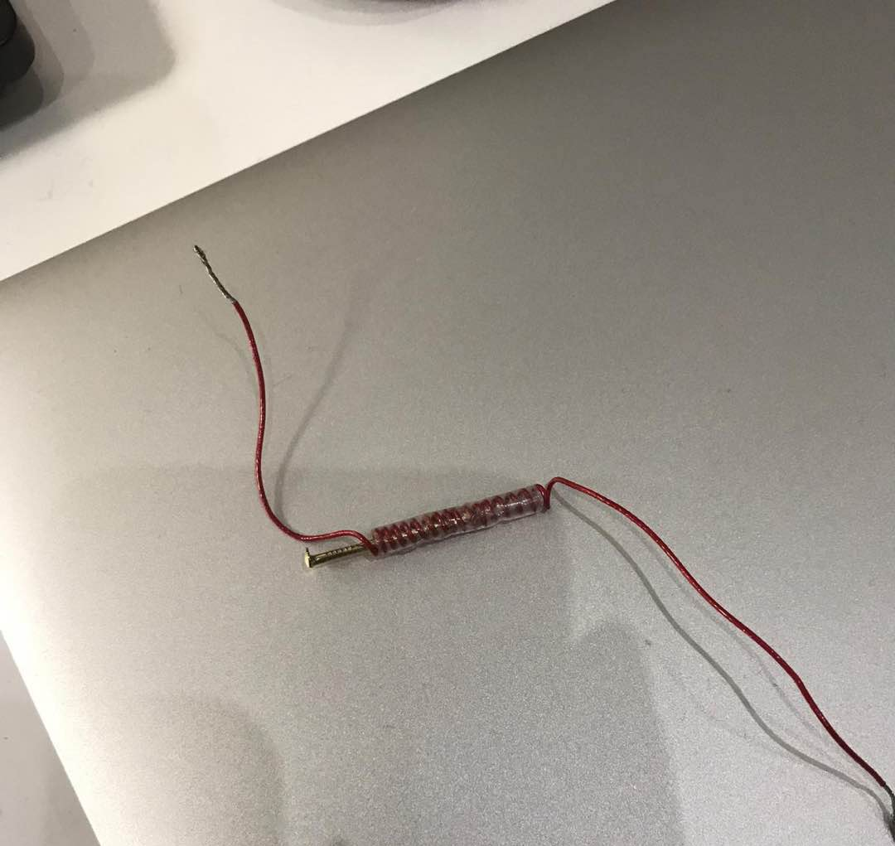
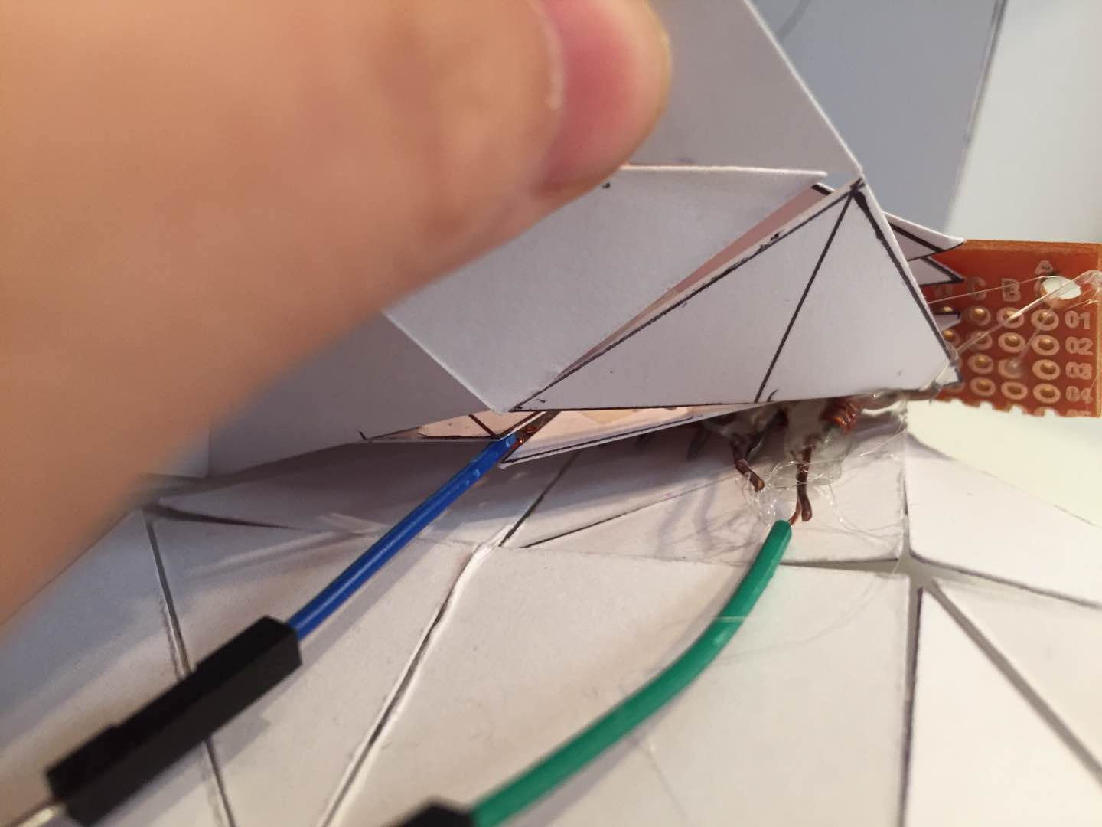
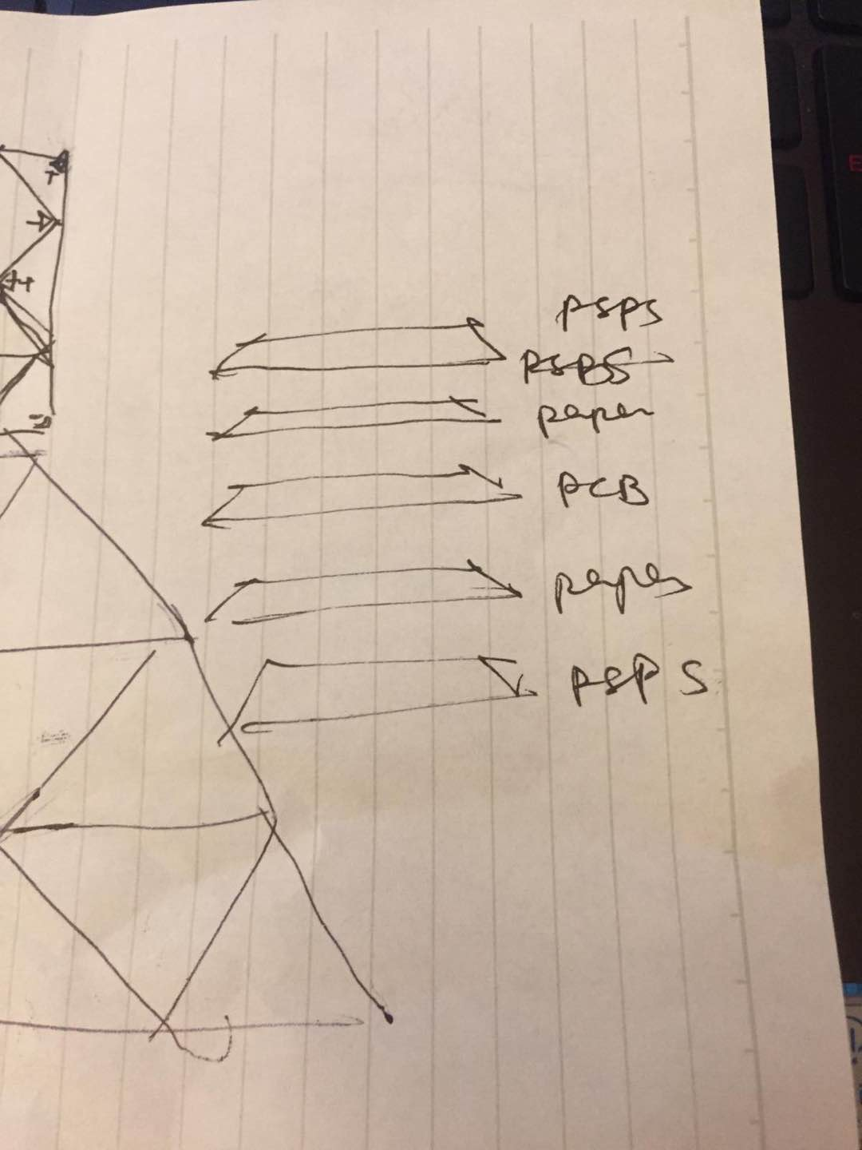
Heating Test
· paper
· PSPS
· currents
EXP 3

Slide 13
EXP 1
EXP 2
EXP 3
Nylon Test
· need high pull
· heating temperature 60°-70°
· deformation can not maintain the structure
· time costing
Liquid Test
· get really wet
· pre-leading fluid low
· deformation can not maintain the structure
· impossible to re-change the form
· only work with drawing paper with high volume
· tiny deformation
· paper got broken
Heating Test
· temperature requiring too high
· burn off 2 control board
· deformation too tiny to catch
· psps hard to crush
· the thickness of material goes high
RESULTS

